Slide 1
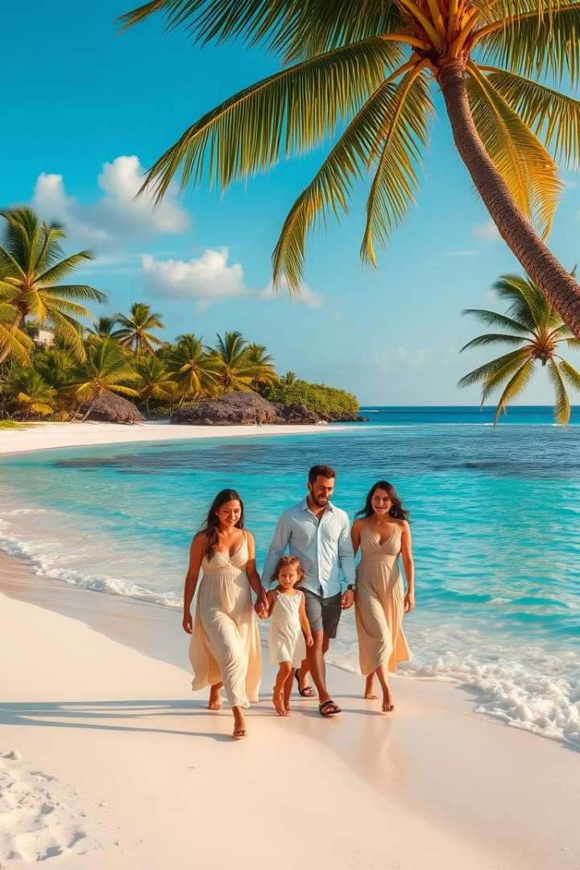
Your Dream Mauritius Family Getaway
Welcome to your bespoke Mauritius itinerary, curated for a memorable and stress-free family holiday. Relax on pristine beaches, explore captivating sights, and savor the island's charm. This guide outlines your arrival, accommodation, transportation, activities, and budget, ensuring a seamless and unforgettable experience.
KO
by Khadijat Oduyemi

Slide 2
Welcome to Mauritius: Arrival Essentials
Passport & Visa
Vaccinations
Travel Insurance
Ensure your passports are valid for at least 6 months beyond your return date. UK citizens require no visa for stays up to 60 days, receiving one upon arrival.
While no mandatory vaccinations are required, ensure all routine vaccines are up-to-date. Consult your GP for any recommended vaccinations.
Acquire comprehensive travel insurance covering medical emergencies, cancellations, and lost luggage. This provides peace of mind throughout your trip.
Khadijat Oduyemi

Slide 3
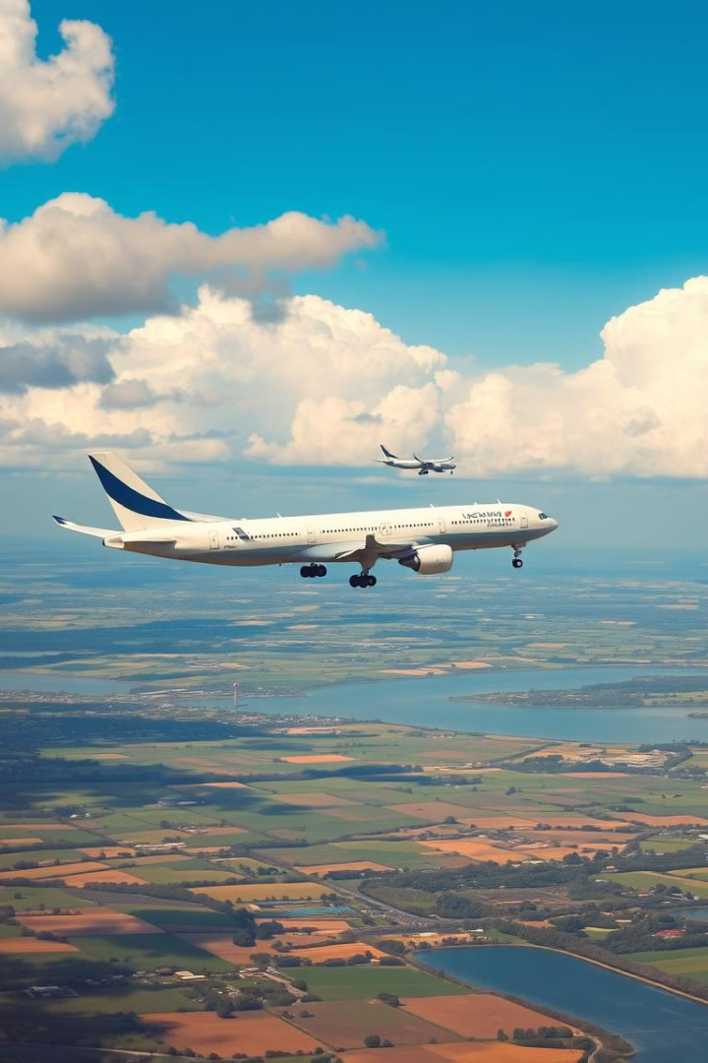
Effortless Journey: Flight Itinerary
1
London Gatwick to Dubai
Departing from London Gatwick at 21:45 on June 2nd, you’ll enjoy a comfortable 6-hour 50-minute flight with Emirates, arriving in Dubai at 07:35 on June 3rd.
2
Dubai Layover
Enjoy a relaxed 2-hour 30-minute layover in Dubai, allowing time to refresh and explore the airport.
3
Dubai to Mauritius
Embark on your final leg at 10:05, arriving in Mauritius at 16:40. You’ll be met by your private driver for a smooth transfer to your accommodation.
Khadijat Oduyemi

Slide 4
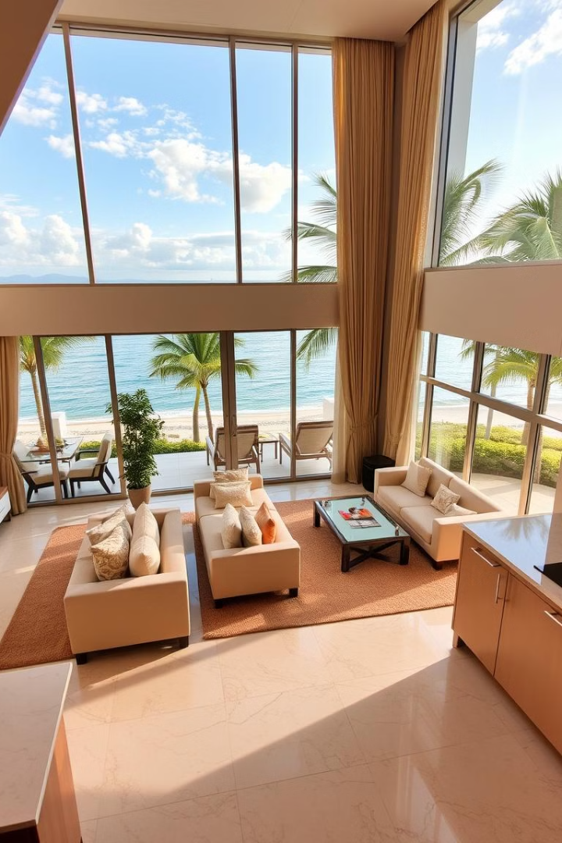
Your Comfortable Home Away from Home
Amenities
Accessibility
Enjoy a spacious 2-bedroom apartment with a fully equipped kitchen, a private terrace, and comfortable living areas. Relax in soundproof rooms with air conditioning, perfect for a peaceful family getaway.
Located in a village near the bay and boardwalk, your apartment is easily accessible with nearby golfing, boat tours, fishing, snorkeling, scuba diving, and parasailing.
Entertainment
Enjoy a 32-inch flat-screen TV with digital channels, a laptop workspace for remote work, and blackout drapes for a restful night's sleep.

Slide 5
Exploring Mauritius: Activities & Excursions
Snorkeling at Blue Bay Marine Park
Casela World of Adventures
Embark on a captivating snorkeling adventure at Blue Bay Marine Park, a protected area teeming with vibrant marine life. Professional guides will lead you through crystal-clear waters, revealing a colorful underwater world.
Immerse yourselves in Casela World of Adventures, a thrilling park offering a diverse range of activities. Encounter exotic animals, soar on ziplines, and embark on exciting safaris.
Khadijat Oduyemi

Slide 6
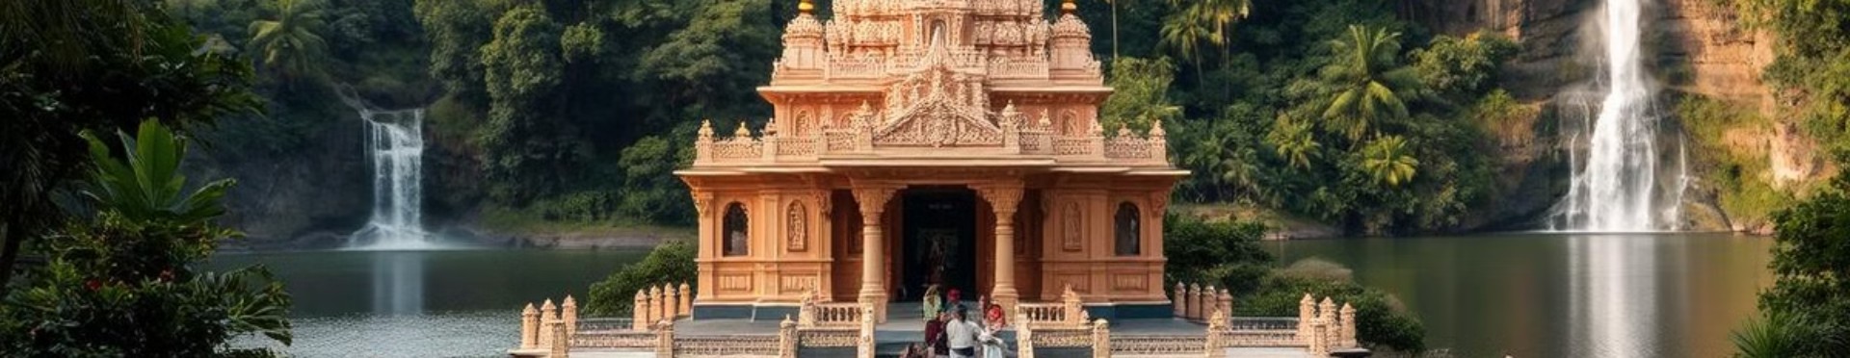


Island Culture & Spiritual Encounters
SSR Botanical Gardens
Grand Bassin (Ganga Talao)
Explore the vibrant SSR Botanical Gardens, a haven of lush greenery and diverse flora. Encounter giant tortoises, stroll through serene pathways, and enjoy the beauty of nature.
Embark on a spiritual journey to Grand Bassin (Ganga Talao), a sacred Hindu temple, and take in the serene lake and a waterfall. Witness the vibrant religious rituals and experience a profound sense of tranquility.
Khadijat Oduyemi

Slide 7
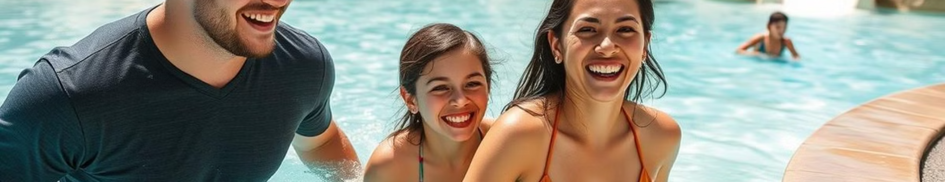
A Day of Thrills & Relaxation
Resort Leisure
Waterpark Adventure
Indulge in pure relaxation at the resort. Enjoy the beach, lounge by the pool, and maybe treat yourselves to a rejuvenating spa treatment.
Unleash your inner child at a vibrant waterpark, filled with thrilling slides, a wave pool, and a lazy river. Enjoy a fun-filled day with the entire family, creating lasting memories.
Khadijat Oduyemi

Slide 8

Bon Voyage: Farewell & Next Steps
As your Mauritius adventure draws to a close, cherish the memories you've created and the experiences you've shared. We hope this curated itinerary has provided a seamless and unforgettable holiday for your family. Thank you for entrusting us with planning your dream getaway.

